Slide 1

Optimizing Inventory Management for an Online Retail Store
Presented by:
Yeswanth Reddy Chereddy
Vishal Balaji Kotrike
Koushik Choppakatla
Hansika Karnati
Yeshwanth Rayankula

Slide 2
Overview
Introduction
Factors to Analyze
Target Users
Visualizations from Jupyter Notebook
Outcomes
Benefits
Conclusion

Slide 3
Introduction
We are building a SQL project for optimizing inventory management for an online retail store, which refers to strategically managing and controlling the inventories.
Inefficient inventory management in online retail stores leads to increased costs, poor customer satisfaction, and operational inefficiencies.
Online retail stores face unique inventory management challenges due to factors such as fluctuating customer demand, diverse product offerings, and dynamic market conditions.
This presentation focuses on analyzing key factors such as total quantity sold, slow-moving products, revenue generation, and high-profit margin items.

Slide 4
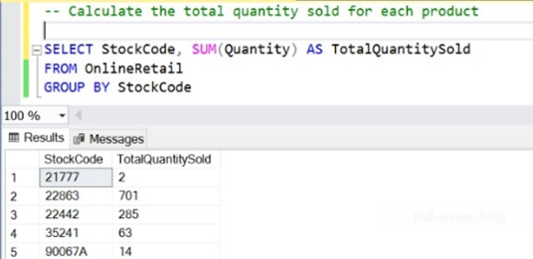
Factors to Analyze
Total Quantity Sold:
Calculate the total quantity sold for each product.
Helps in understanding product demand and identifying popular items.

Slide 5
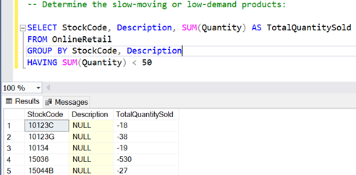
Slow-Moving and Low-Demand Products:
Identify products with low sales velocity.
Helps in reallocating resources, avoiding overstocking, and reducing carrying costs.

Slide 6
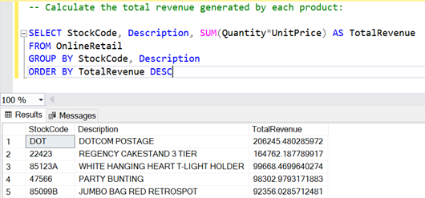
Total Revenue Generated:
Calculate the total revenue generated by each product.
Enables analysis of sales performance and identification of high-revenue products.

Slide 7
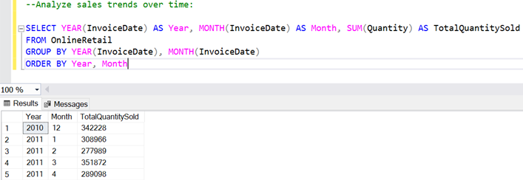
Analyze Sale trends over time:
Identify products with high sales over time.
Allows for focusing on future demand, plan inventory levels accordingly.

Slide 8
Target Users
Sales Representatives
E-commerce managers
Product managers
Inventory Auditors
Supply chain managers
Sales managers
Logistics managers

Slide 9
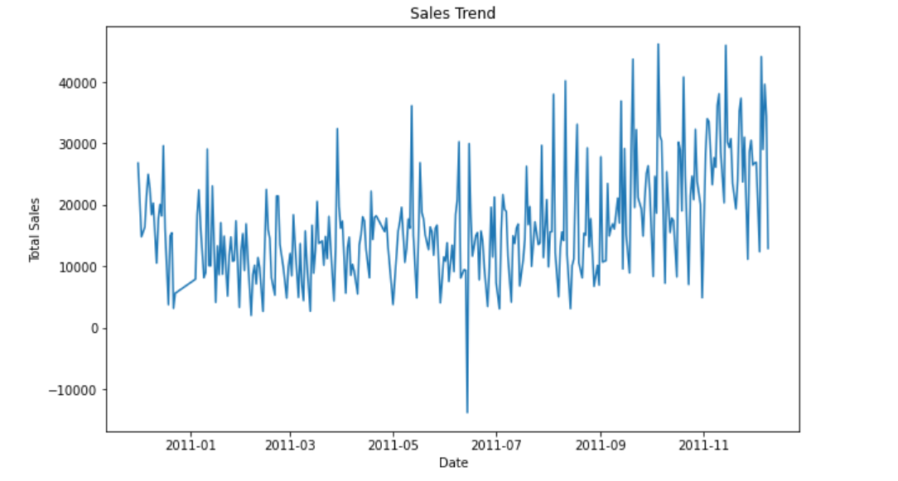
Visualizations from Jupyter Notebook

Slide 10
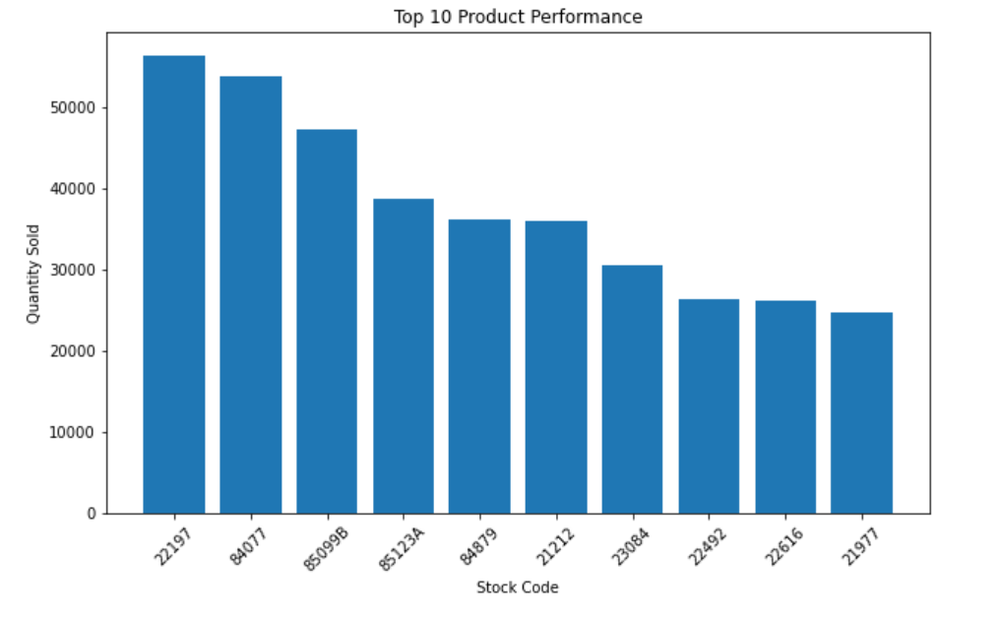
.

Slide 11
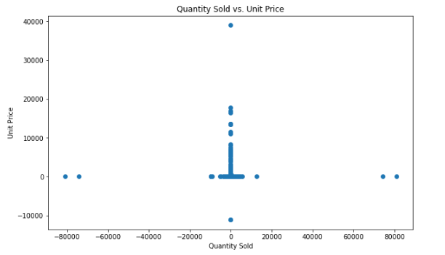

Slide 12
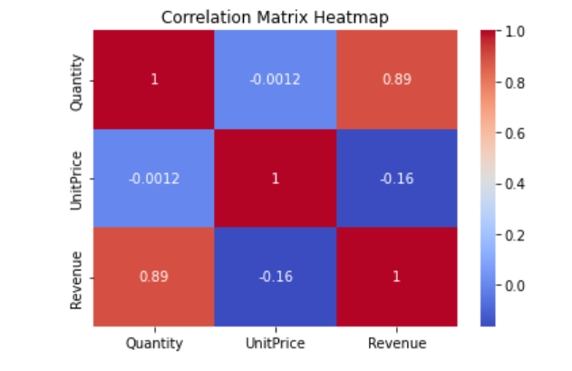
Correlation:

Slide 13
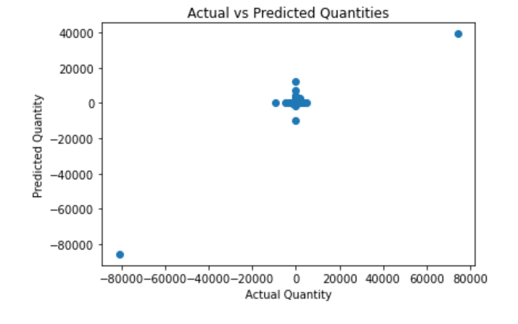
Scatter Plot:We created a scatter plot to visualize the actual quantities versus the predicted quantities. This will help to understand how well the model is predicting the quantities.

Slide 14
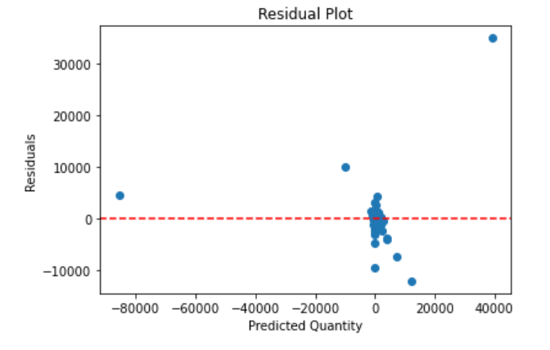
Residual Plot:A residual plot shows the difference between the actual and predicted values. It helps in identifying any patterns or biases in the predictions.

Slide 15
Outcomes
In the given correlation matrix, the quantity column has a strong positive correlation with revenue (0.89). This implies that there is a significant relationship between the quantity of items sold and the revenue generated.
To optimize inventory management using the quantity column, we can consider the following approaches:
Demand Forecasting
Reorder Point Calculation
Inventory Optimization
Seasonality Analysis
The accuracy of the model we got after training, testing, and evaluating the model is 82.57%.

Slide 16
Benefits of Optimizing Inventory Management
Reduced stock outs
Minimized excess inventory
Improved cash flow
Enhanced operational performance
Improved Customer Satisfaction
Data-Driven Decision Making
Efficient Order Fulfillment
Enhanced Forecasting and Planning

Slide 17
Conclusion
Optimizing inventory management is vital for online retail stores to reduce costs, enhance efficiency, and meet customer demand.
Effective inventory management minimizes stock outs, excess inventory, and improves operational performance.
Key factors to analyze include total quantity sold, slow-moving products, revenue generated, and high-profit margin items.
Utilizing tools like SQL Server Management Studio and Jupyter Notebook enables data analysis and visualization.
Benefits include improved customer satisfaction, cost reduction, better cash flow, efficient order fulfillment, and data-driven decision making.

Slide 18
References
References
Capella. (2022, December 30). Retrieved from The Power of Data Management in Retail and e-Commerce: https://www.capellasolutions.com/blog/data-management-in-retail-and-e-commerce
Dee, C. (2023, March 15). Algolia. Retrieved from https://www.algolia.com/blog/ecommerce/how-to-increase-your-sales-and-roi-with-optimized-ecommerce-merchandising/
Eliaçık, E. (2022, August 31). Data Conomy. Retrieved from https://dataconomy.com/2022/08/31/machine-learning-in-retail-use
cases/#:~:text=A%20machine%20learning%20model%20for,consumer%20needs%20through%20appropriate%20segmentation
Gavett, G. (2014, May 09). Harvard Business Review. Retrieved from https://hbr.org/2014/05/how-data-visualization-answered-one-of-retails-most-vexing-questions
Valluri, S. (2020, March 10). Oracle Database Insider. Retrieved from https://blogs.oracle.com/database/post/six-retail-dashboards-for-data-visualizations

Slide 19
THANK YOU...

